Slide 1
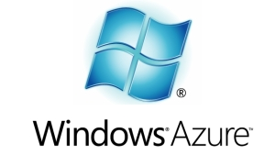
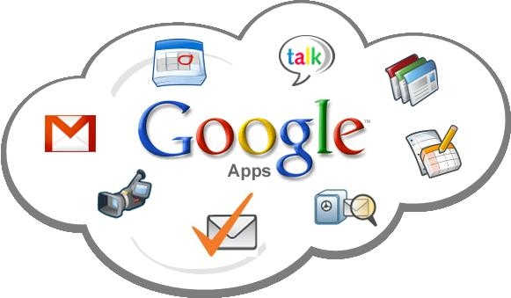

Cloud Computing
By: Joshua Wiegand

Slide 2
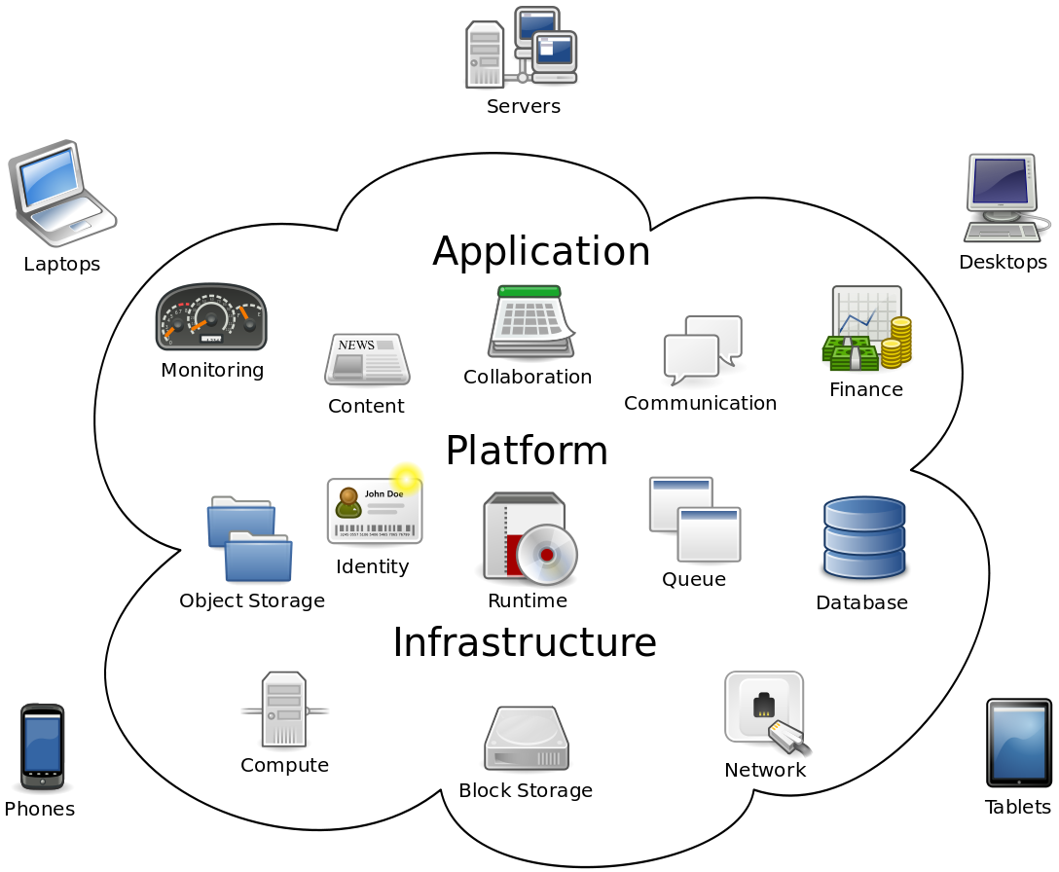
Overview
What is the cloud computing?
History of Mobile Computing
Service Models
Deployment Models
Architecture
Security
Cloud Clients
Issues, Research
Why its important?
Q&A

Slide 3
What is Cloud Computing?
Cloud computing:(noun)
Internet-based computing in which large groups of remote servers are networked so as to allow sharing of data-processing tasks, centralized data storage, and online access to computer services or resources.
Any computer related task that is done entirely on the Internet

Slide 4
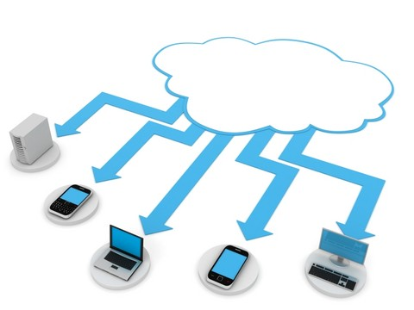
What is Cloud Computing?
Allows users to deal with the software without having the hardware.
Everything is done by remote, nothing is saved locally.

Slide 5
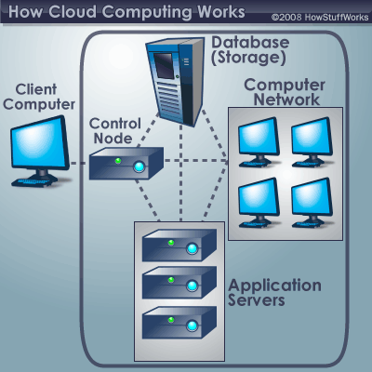
Characteristics
Empowerment
Agility
API
Cost
Device and location independence
Visualization
Multi-tenancy
Reliability
Scalability and Elasticity
Security
Maintenance

Slide 6

History
50's & 60's: theorized that the world would have cloud computing
90's: start of VPNs and efficient infustructure
00's: Amazon builds efficient servers/ AWS

Slide 7
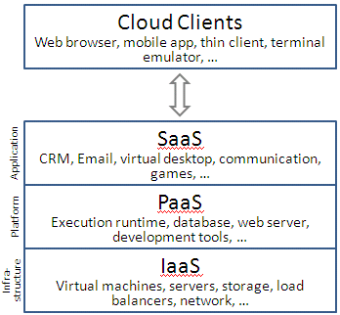
Service Models
Infrastructure as a Service (IaaS)
Basic, service users maintain software
Platform as a Service (PaaS)
Users are given software and hardware automatically
Software as a Service (SaaS)
All software and hardware is transparent
User only knows their own access point

Slide 8
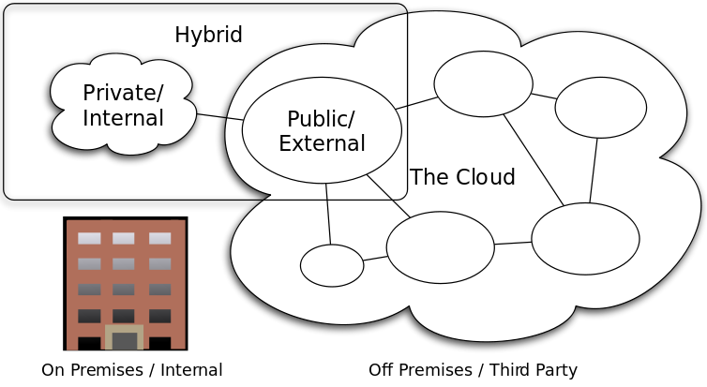
Deployment Models
Public cloud
Done by service providers
Community cloud
organizations from a specific community with common concerns
Private cloud
operated solely for a single organization
Hybrid cloud
composition of two or more clouds (private, community or public)
Private Cloud Rentals
option to consider when security is a concern

Slide 9
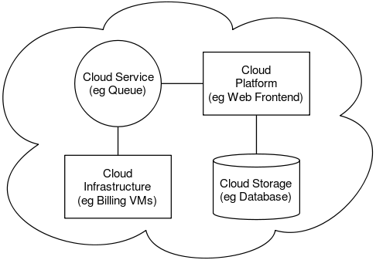
Architecture
The software systems involved in the delivery, communicating over a loose coupling mechanism
The Intercloud
The Intercloud is an interconnected global "cloud of clouds" and an extension of the Internet
Cloud Engineering

Slide 10

Cloud Engineering
The application of engineering disciplines to cloud computing
High level concerns
Commercialisation
Standardisation
Governance in
Conceiving
Developing
Operating
maintaining

Slide 11

Security and privacy
Data protection
Physical Control
Identity management
Physical and personnel security
Availability
Application security
Privacy
Legal issues

Slide 12
Compliance/ Legal Issues
Business continuity and data recovery
Logs and audit trails
Unique compliance requirements
Public records
Legal issues may also include records-keeping requirements in the public sector

Slide 13
Other Issues
Abuse
a banking trojan illegally used the popular Amazon service as a command and control channel that issued software updates and malicious instructions to PCs that were infected by the malware
Open source
provided the foundation for many cloud computing implementations
Open standards
Some vendors have adopted others' APIs and there are a number of open standards under development, with a view to delivering interoperability and portability
Sustainability
often assumed to be a form of "green computing", there is as of yet no published study to substantiate this assumption

Slide 14

Research
Continues to grow
Increases with the explosion of cloud computing
High speed/ performance is heavily researched

Slide 15
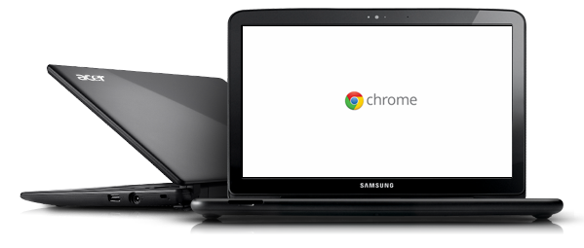
Cloud Clients
Google Chromebook
Web browsers
Company specific applications

Slide 16

Importance
We use clouds everyday
Used to save huge amounts of data
Make maintaining information easy
Makes security easy
Maintainability and sustainability are better

Slide 17
Questions?

Slide 18
Sources
"cloud computing." Dictionary.com Unabridged. Random House, Inc. 27 Feb. 2012. <Dictionary.com http://dictionary.reference.com/browse/cloud computing>.
“Cloud computing security.” Wikipedia, The Free Encyclopedia. Wikimedia Foundation, Inc.. 20 Feb 2012. Web. 27 Feb 2012. <http://en.wikipedia.org/wiki/Cloud_computing_security>.
“Cloud computing.” Wikipedia, The Free Encyclopedia. Wikimedia Foundation, Inc.. 28 February 2012. Web. 27 Feb 2012. <http://en.wikipedia.org/wiki/Cloud_computing>.
nanospeak, . "Top Cloud Computing Companies List To Watch and Invest in 2012." Hub Pages. 10 Feb 2010: n. page. Web. 29 Feb. 2012. <http://nanospeck.hubpages.com/hub/Best-Cloud-Service-Providers>.

